Slide 1
Prediction of Default of Credit Card Clients
Project Presentation of ISE 444
Bolun Xu & Weiming Lei

Slide 2

Main Purpose
Using financial information to predict whether a client would default
Analysing results and comparing accuracy of 4 main methods
?
?
?

Slide 3
Data
30,000 instances (clients): 70% for training, 30% for test
24 attributes: Include clients’ basic information (age, education ,marriage), history of past payment, amount of bill statement and amount of previous payment
Employed a binary variable, default payment (Yes = 1, No = 0), as the response variable

Slide 4
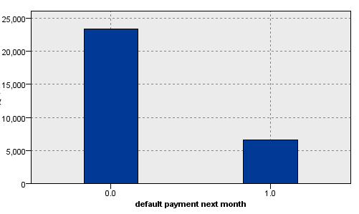
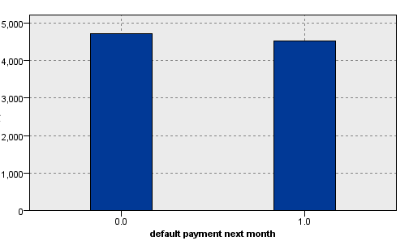
Data Processing
Delete records with missing value(we have enough records)
Delete obvious irrelavent attributes
Balance training data

Slide 5
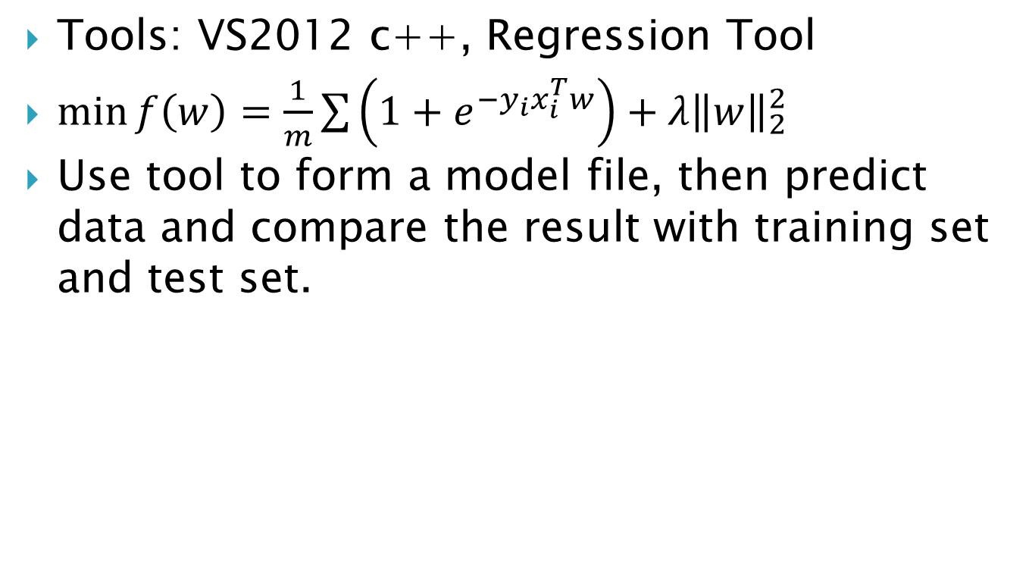
1. Logistic Regression
Tools: VS2012 c++, Regression Tool
$\min{f\left(w\right)}=\frac{1}{m}\sum{\left(1+e^{−y_{i}x_{i}^{T}w}\right)+λ{\left\|w\right\|}_{2}^{2}}$
Use tool to form a model file, then predict data and compare the result with training set and test set.
 | Training | Testing
Accuracy | 64.06 | 63.67

Slide 6

2. SVM
Tools: VS2012 C++, LibSVM3.19
Linear
Polynomial kernel: D=2, 3
RBF: $γ$=0.01, 0.05, 0.10, 0.5, 1, 10. Observed overfitting when$γ$ increase to large enough

Slide 7
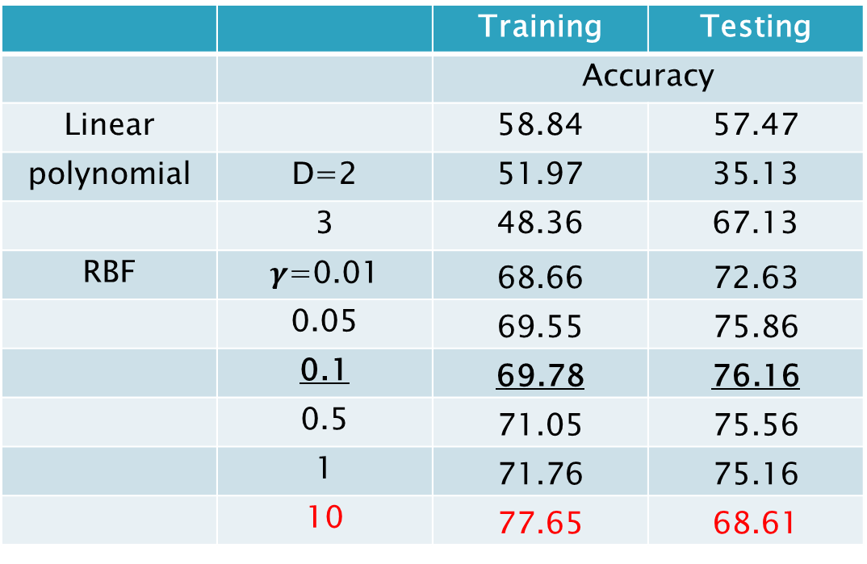
2. SVM
 |  | Training | Testing
 |  | Accuracy
Linear |  | 58.84 | 57.47
polynomial | D=2 | 51.97 | 35.13
 | 3 | 48.36 | 67.13
RBF | $γ$=0.01 | 68.66 | 72.63
 | 0.05 | 69.55 | 75.86
 | 0.1 | 69.78 | 76.16
 | 0.5 | 71.05 | 75.56
 | 1 | 71.76 | 75.16
 | 10 | 77.65 | 68.61

Slide 8
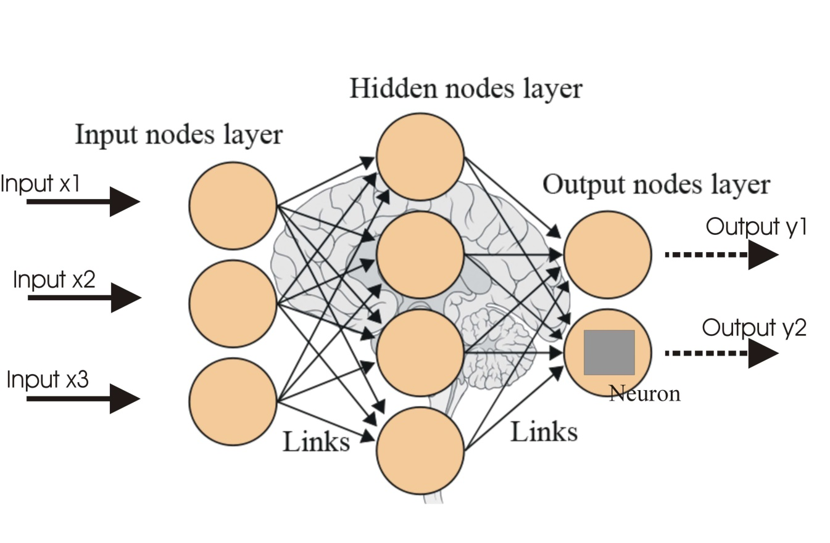
3. Artificial Neural Network
Tool: IBM SPSS/ SAS EM
Paper Read

Slide 9
3. Neural Network
Result
Hidden | Training | Testing | Testing
 | Accuracy |  | Gain at 20%
1 | 68.73 | 77.9 | 47.99
2 | 69.1 | 78.03 | 47.75
3 | 68.91 | 78.45 | 48.27
5 | 70.03 | 77.31 | 48.46
7 | 69.79 | 76.83 | 48.89
9 | 69.64 | 76.06 | 48.79

Slide 10
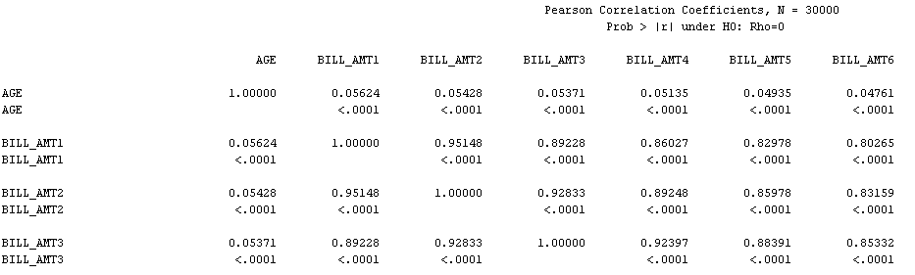
3. Neural Network
Simplify the data. Discard unimportant attributes.
Pearson correlation coefficients Matrices
Feature selection

Slide 11
3. Neural Network
Result
Hidden | Training | Testing | Testing
 | Accuracy |  | Gain at 20%
1 | 71.85 | 80.32 | 48.03
2 | 69.52 | 76.99 | 48.84
3 | 69.83 | 77.36 | 48.93
5 | 69.74 | 76.66 | 49.31
7 | 68.98 | 75.27 | 48.65
9 | 69.32 | 75.88 | 48.27

Slide 12
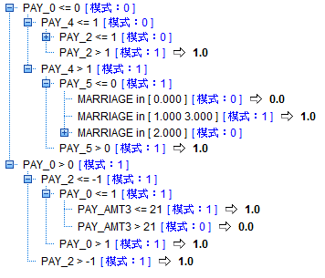
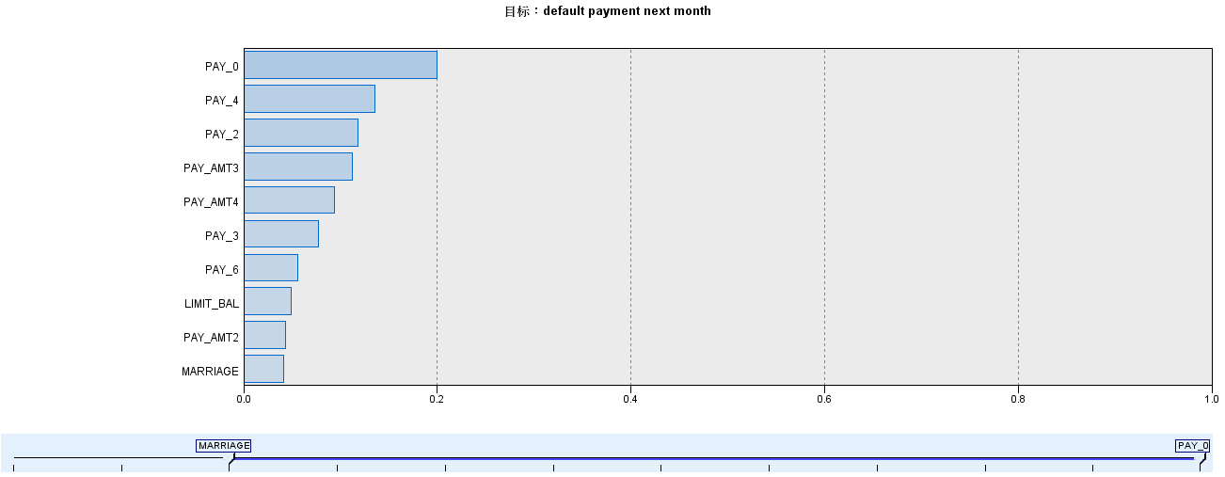
4. Decision Tree
Tool: IBM SPSS/ SAS EM
Method: C5.0, C&R T, CHAID

Slide 13
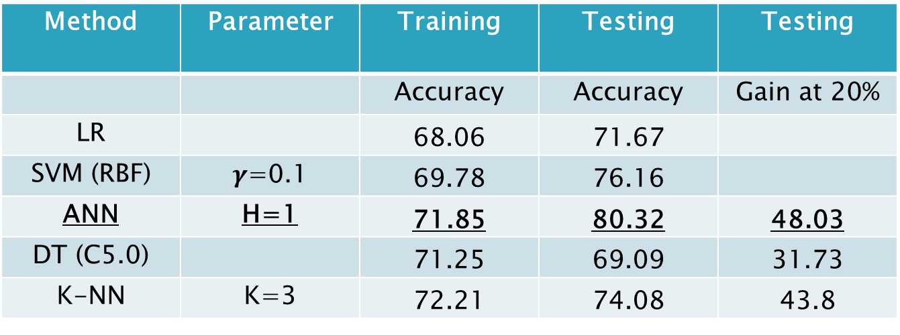
Comparison of Different Methods
Method | Parameter | Training | Testing | Testing
 |  | Accuracy | Accuracy | Gain at 20%
LR |  | 68.06 | 71.67
SVM (RBF) | $γ$=0.1 | 69.78 | 76.16
ANN | H=1 | 71.85 | 80.32 | 48.03
DT (C5.0) |  | 71.25 | 69.09 | 31.73
K-NN | K=3 | 72.21 | 74.08 | 43.8
K-NN: K- Nearest Neighbors Algorithm

Slide 14
Some Conclusions
Nerual 最好
Sex 几乎无关
Education 越高越欠
Marriage，单身的欠
Age 拖欠的平均年龄偏大
欠了以后还会欠

Slide 15
Future Work
SVM polynomial kernel with D>4
Random Tree
Bayes Network

Slide 16
Thank you!

